Slide 1


RGUKT IIIT SRIKAKULAM
FINAL PROJECT
PRESENTED BY LEBAKA PAVAN NAGA SAI
01

Slide 2
RGUKT IIIT SRIKAKULAM
KEY LOGGER AND SECURITY
UNDERSTANDING AND MITIGATING Keylogging Threats
02

Slide 3


AGENDA
01
Introduction
02
Problem Statement
03
Project Overview
04
End Users
05
Solution and Value Proposition
06
The "Wow" Factor in Our Solution
07
Modelling
08
Results
Conclusion and Q&A
03
09

Slide 4

PROBLEM STATEMENT
PROBLEM:
Keyloggers are a significant threat to cybersecurity, leading to unauthorized access to sensitive information, identity theft, and financial fraud.
IMPACT:
Affects individuals, businesses, and organizations by compromising data privacy and security.
04

Slide 5

PROJECT OVERVIEW
Objective:
Develop a comprehensive understanding of keyloggers, their types, how they work, and effective security measures to prevent keylogging attacks.
Scope:
Includes an analysis of hardware and software keyloggers, legal and ethical implications, security measures, and best practices.
05

Slide 6
WHO ARE THE END USERS:
Individuals:
Concerned about personal data security and privacy.
Businesses:
Need to protect corporate data and ensure compliance with
security standards.
Organizations:
Require robust security measures to safeguard sensitive
information.
Security Professionals:
Aim to understand and mitigate keylogging threats.
06

Slide 7
YOUR SOLUTION AND ITS VALUE PROPOSITION
To avoid keyloggers
Use anti virus program
Use password manager
Use multi factor authentication
Use a firewall
Avoid suspicious links and downloads
Change password periodically
Update your system
Use Virtual Keyboard to type passwords and sensitive
information
07

Slide 8
YOUR SOLUTION AND ITS VALUE PROPOSITION
Solution:
Implement a multi-layered security strategy that includes anti-keylogging software, regular system scans, software updates,and user education.
Value Proposition:
Enhanced Security:
Reduces the risk of data breaches and identity theft.
User Awareness:
Educates users about keylogging threats and protection methods.
Compliance:
Helps businesses and organizations comply with data protection regulations.
08

Slide 9
THE WOW IN YOUR SOLUTION:
Innovative Approach:
Combining technical measures with user education for comprehensive protection.
Demonstration:
Real-time demonstration of a simple keylogger to illustrate the threat and the effectiveness of security measures.
Impact:
Significant reduction in the likelihood of keylogging attacks through proactive measures.
09

Slide 10
MODELLING:
Architecture Overview:
Modular Design:
The keylogger code is structured into modular functions for better readability and maintenance.
Event Handling:
Utilizes the pynput library to capture and handle keyboard events.
Data Logging:
Implements functions to log captured data into text and JSON files.
10

Slide 11
COMPONENTS:
Key Press Handling:
Function:
on_press(key)
Description:
Captures and logs the pressed keys.
Details:
Appends key press events to a list and updates the JSON log file.
Key Release Handling:
Function:
on_release(key)
Description:
Captures and logs the released keys.
Details:
Appends key release events to a list, updates the JSON log file, and accumulates keys for the text log.
11

Slide 12
COMPONENTS:
Logging Functions:
Text Logging:
generate_text_log(key)
Description:
Writes the recorded keys to key_log.txt.
jSON Logging:
Jgenerate_json_file(keys_used)
Description:
Dumps the list of key events to key_log.json.
12

Slide 13
GUI INTEGRATION:
Tkinter Framework:
Utilizes tkinter for creating a graphical user interface.
User Interaction:
Start Button:
Initiates the keylogger.
Stop Button:
Stops the keylogger.
Status Updates:
Provides real-time feedback on the status of the keylogger (running/stopped).
13

Slide 14
FLOW DIAGRAM:
Initialization:
Set up the main GUI window.
Initialize global variables for key logging.
Event Capture:
Start capturing key events when the "Start" button is pressed.
Log key press and release events.
Data Logging:
Continuously update text and JSON log files with captured key events.
Stop Logging:
Stop capturing key events when the "Stop" button is pressed.
Update the GUI status to indicate the keylogger is stopped.
14

Slide 15
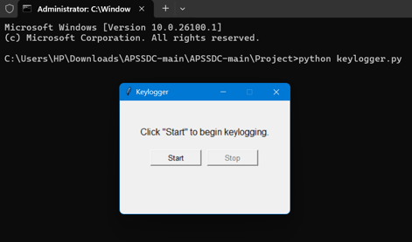
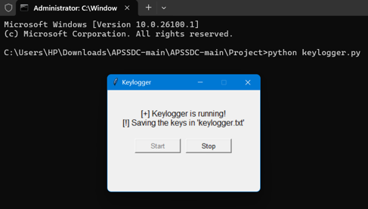
RESULTS:
15

Slide 16
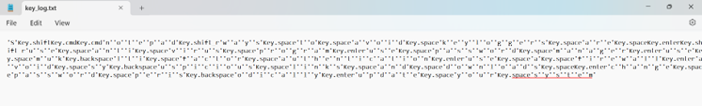
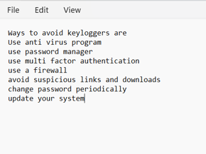
RESULTS:
Screenshots of the GUI:
Display the user interface, including the start and stop buttons, and the status label.
Sample Logs:
Show examples of the key_log.txt and key_log.json files to illustrate how the
keystrokes are recorded.
16

Slide 17
CONCLUSION:
Successfully implemented a keylogger that captures keystrokes and records them into both text and JSON files.
Real-time keylogging with start and stop functionality controlled via a simple GUI.
The keylogger project demonstrated the capability to effectively capture and log keystrokes in real-time.
The GUI provided a user-friendly way to control the keylogger, making it accessible and easy to use.
Emphasized the ethical use of keyloggers and the importance of implementing security measures to protect against malicious use.
17

Slide 18
GIT LINK:
https://github.com/Pavan-Lebaka/apssdc_keylogger-main.git
18

Slide 19
THANK YOU
PAVAN NAGA SAI LEBAKA
19

